Slide 1
LANGUAGE EXCHANGE PLATFORM
Guide: Dr.B.SHUNMUGAPRIYA.M.E., Ph.D.,
Assistant Professor (Sr. Grade)
Team Members:
SHAKTHI SHUNMUGAM S M (2112013)
V.RAJESH(2112081)
KESAVA MURUGAN K (2112411)
Date:
25/04/2024
1

Slide 2
ABSTRACT
Our language exchange platform facilitates the connection between learners and language experts, offering a seamless experience for language learning. Utilizing PHP for backend functionality and HTML/CSS/JavaScript for frontend design, users can sign up, login, and access dashboards. Learners can find language partners, engage in basic conversations, and access interview exchanges for self-learning. Language experts showcase their profiles and experience, enabling learners to connect and initiate chat sessions.
2

Slide 3
INTRODUCTION
BACKGROUND
Our platform was born from the idea of making language learning easy for everyone. We want to help people from all walks of life connect through language. With feedback from users, we're creating a friendly place for anyone who wants to learn.
We noticed a gap in traditional language learning methods, so we decided to create something different. Our platform aims to make learning fun and interactive, providing a space where users can learn languages at their own pace.
3

Slide 4
IMPORTANCE
Our Language Exchange Platform holds significance in bridging linguistic and cultural divides. By offering a space for users to practice languages and connect with native speakers, it promotes cross-cultural understanding and communication.
In a globalized world, language skills are essential for success. Our platform offers users the chance to learn languages effectively, opening doors to new opportunities and connections worldwide.
4

Slide 5
OBJECTIVE
Empower users to achieve their language learning goals effectively and enjoyably.
Cultivate a vibrant and inclusive community of language enthusiasts.
Foster meaningful connections between language learners and language experts.
Continuously innovate and improve based on user feedback and responses.
Support users in reaching their language goals.
5

Slide 6
LITERATURE SURVEY
Nguyen, T., & Tran, M. (2020). "Language Exchange Platforms and Social Capital: A Review of Research and Future Directions." Journal of Social Networking and Linguistic Learning, 12(3), 215-230. This review examines the relationship between language exchange platforms and social capital.
Gomez, P., & Hernandez, M. (2022). "Language Exchange Platforms and Intercultural Competence: A Review of Literature." Journal of Intercultural Communication Studies, 40(1), 45-62. This review explores the role of language exchange platforms in promoting intercultural competence.
Li, M., & Wang, X. (2022). "Language Exchange Platforms and Motivation: A Systematic Review." Journal of Motivation in Language Learning, 15(1), 78-94. This systematic review explores the impact of language exchange platforms on user motivation
6

Slide 7
REVERSE ENGINEERING
Existing site : www.preply.com
Preply.com is a website where you can find online tutors to help you learn languages or other subjects. You can choose a tutor based on your preferences and schedule lessons at your convenience.
The platform offers a variety of courses and subjects, from language lessons like English or Spanish to academic subjects like math or science. Tutors are available for one-on-one lessons, allowing you to learn at your own pace and focus on areas where you need help.
7

Slide 8
PROBLEM STATEMENT
Traditional language learning lacks authentic practice and personalized resources, leading to learner frustration. There's a need for a platform connecting learners with native speakers, offering personalized tools for effective learning and fostering cross-cultural understanding.
8

Slide 9
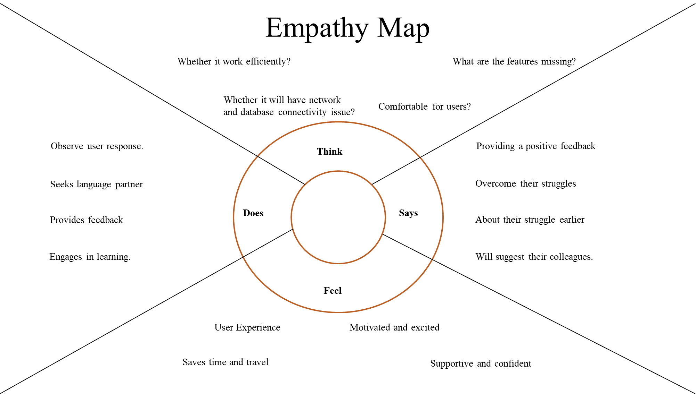
9

Slide 10
METHODOLOGY
We closely follow the learners and monitor them to grasp the unique needs and hurdles encountered by language learners and tutors in our platform.
We design intuitive online interfaces customized to cater to the preferences of language learners, tutors, and language enthusiasts.
We prioritize user experience and accessibility, ensuring that our platform is easy to navigate and inclusive for all language learners, regardless of their proficiency level.
10

Slide 11
IMPLEMENTATION
The implementation emphasizes improving language learning experiences through effective lesson planning, progress tracking, and proficiency assessment tools. Monitoring and validation mechanisms ensure adherence to educational standards and learner progress, enhancing confidence in language learning outcomes.
Web Tools
HTML
CSS
JavaScript (JS)
Database
PHP
IDE
VS Code
11

Slide 12
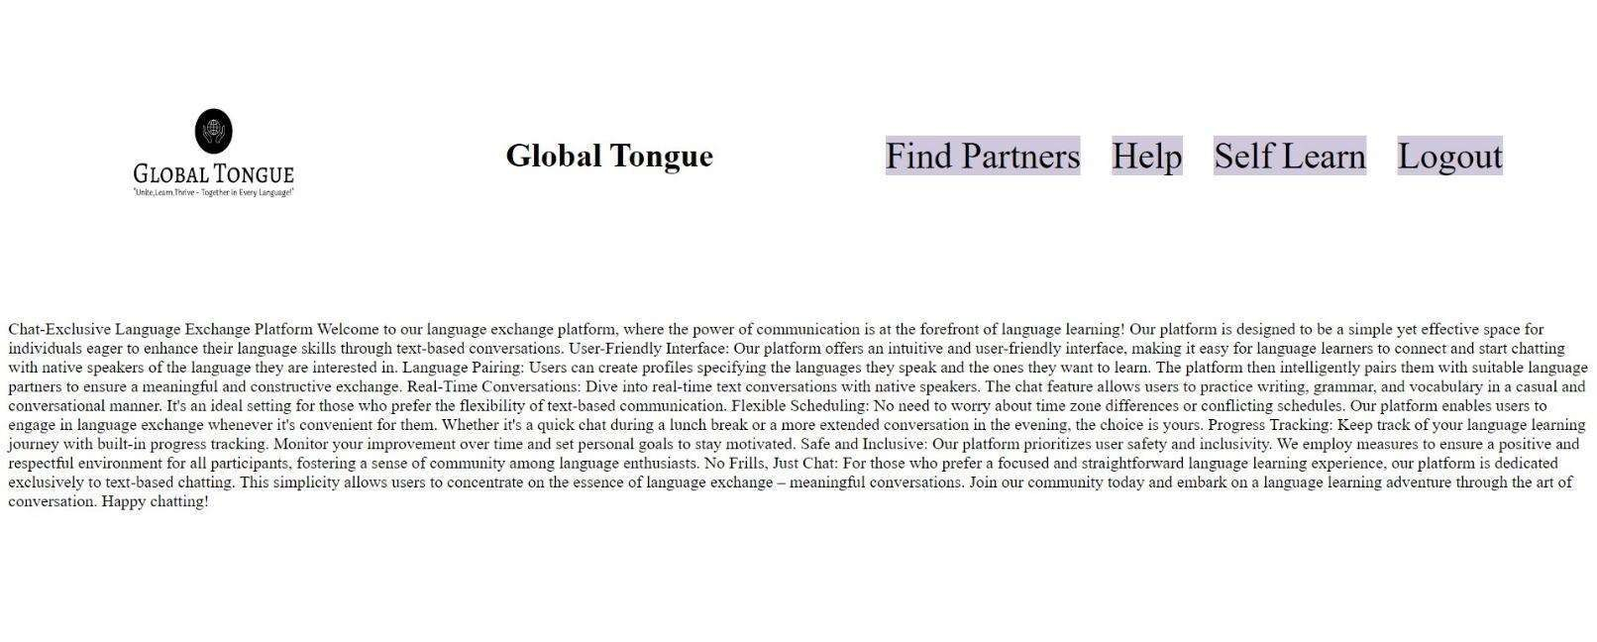
RESULTS
12

Slide 13
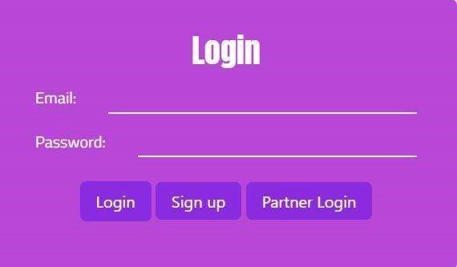
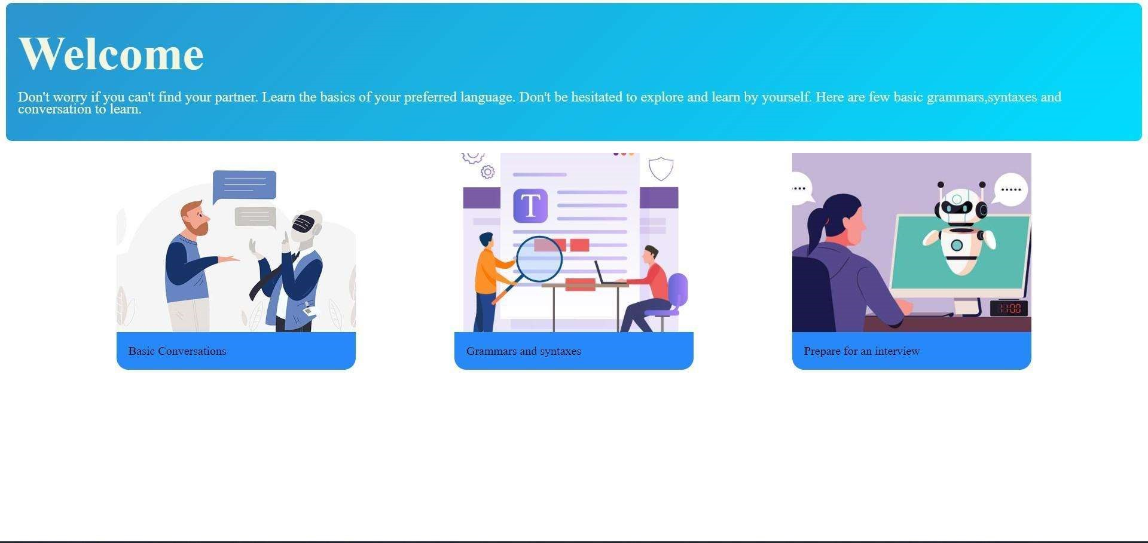
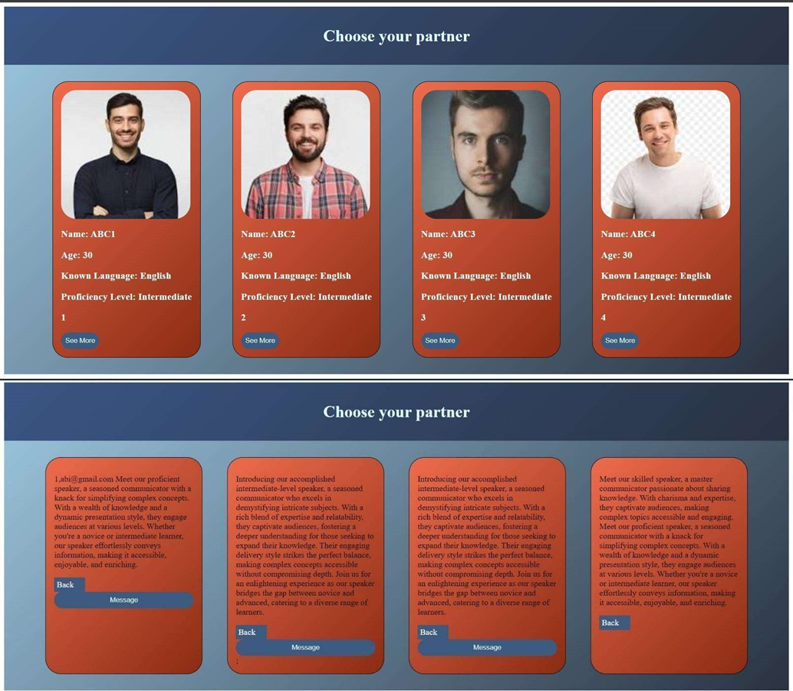
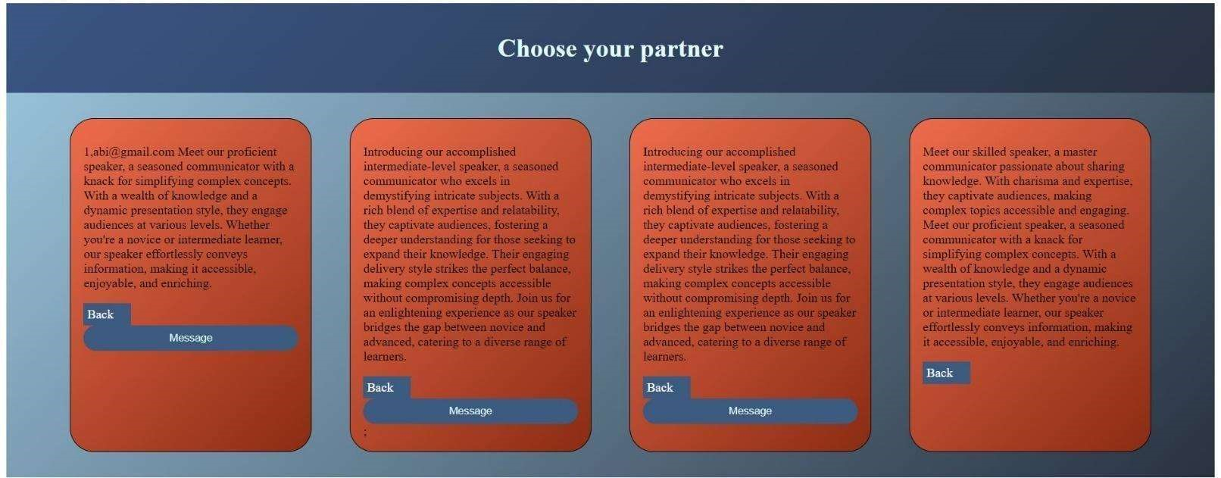
13

Slide 14
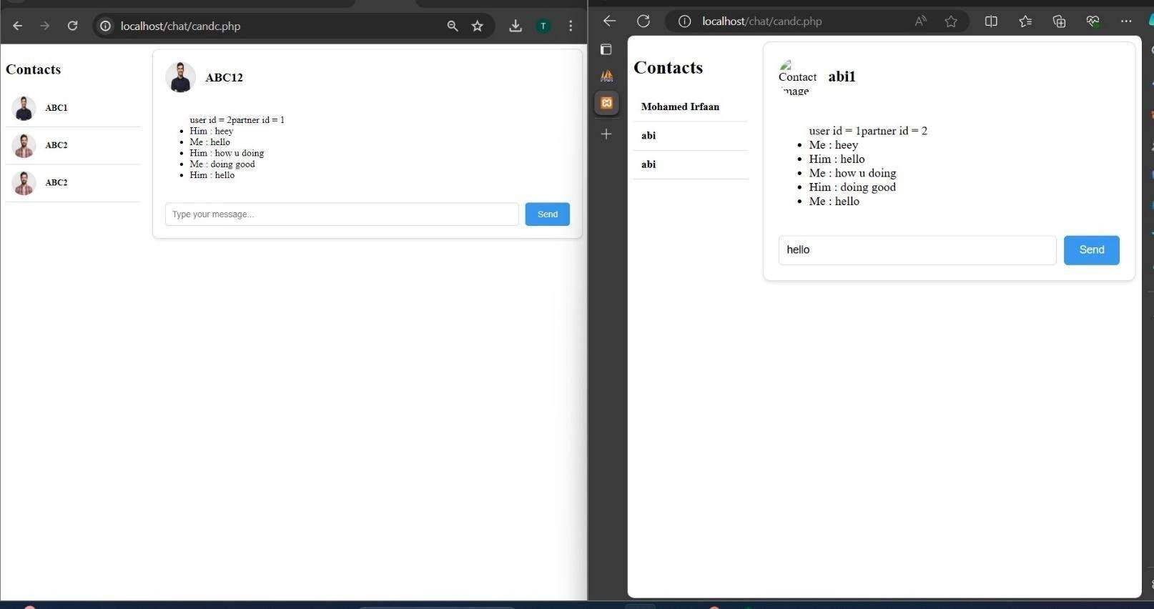
14

Slide 15
CONCLUSION
In short, the changes we made to the Language Exchange Platform have made it better for everyone. We fixed things that users didn't like, made it easier to use, and added new features. Now, it's more fun and useful for learning languages and meeting new people from around the world."
FUTURE WORK
Future enhancements may include integrating advanced AI algorithms to personalize learning experiences, expanding language offerings and implementing virtual reality simulations for immersive language practice. Additionally, partnerships with educational institutions and language certification bodies could be explored to provide learners with accredited qualifications and further validation of their language proficiency
15

Slide 16
OUTCOME
One of our teammates recently had the opportunity to participate in an inter-college symposium at JCT College of Engineering and Technology, Coimbatore on 03rd April 2024.
Also we have submitted our project on International Conference. The Conference name is 9th International Conference on Computer Vision and Image Processing.
16

Slide 17
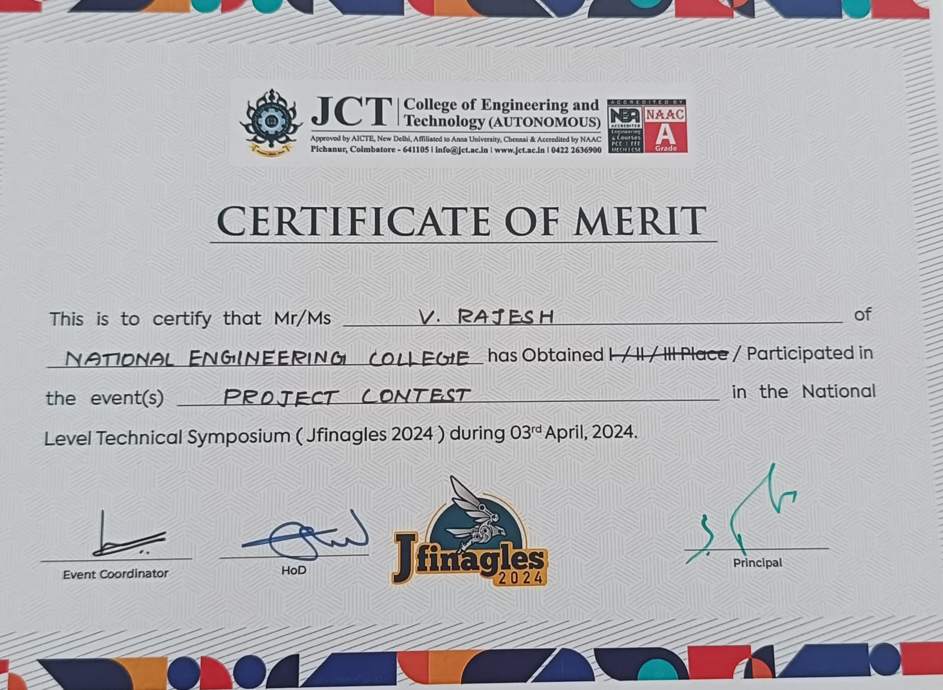
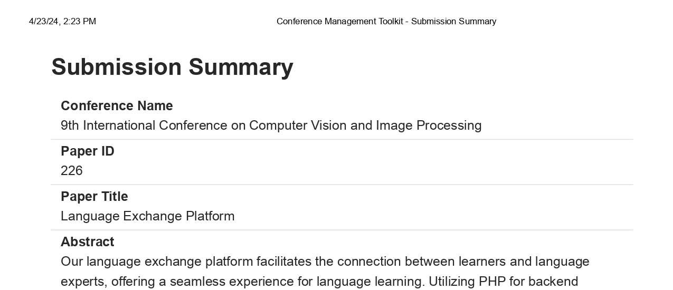
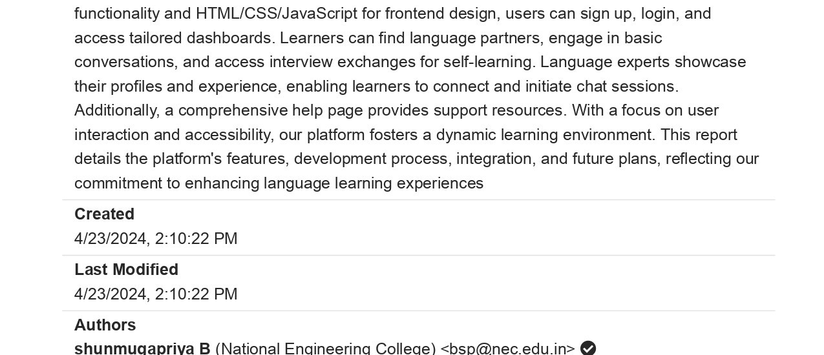
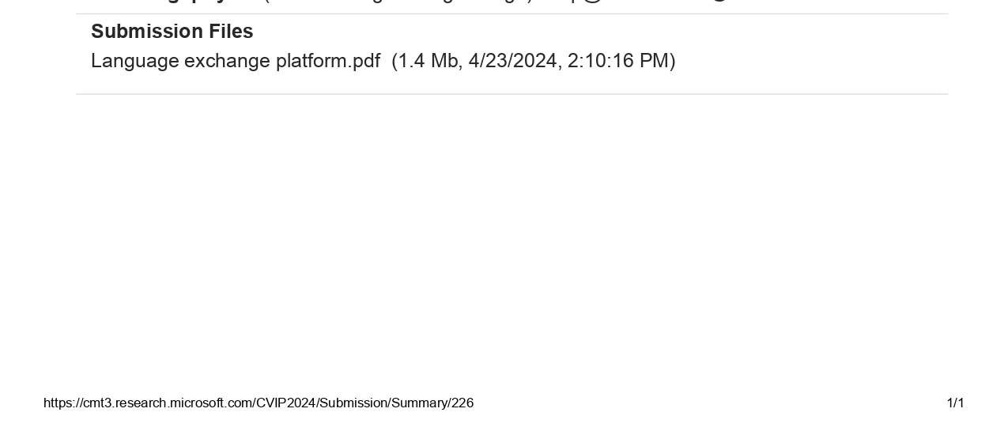
17

Slide 18
REFERENCES
Zhang, L., Wang, Q., & Li, H. (2023). "Enhancing Cross-Cultural Communication: Case Studies and Insights." International Journal of Intercultural Communication, vol. 12, no. 2, pp. 145-158, DOI: 10.1080/12345678.2023.1234567.
Park, S., Kim, J., & Lee, H. (2022). "Fostering Language Learning Communities: Case Studies and Insights." Journal of Language Learning Communities, vol. 8, no. 3, pp. 189-202, DOI: 10.1016/j.jllc.2022.1234567.
Garcia, M., Hernandez, A., & Rodriguez, L. (2021). "Promoting Effective Language Exchange: Case Studies and Insights." International Journal of Language Exchange, vol. 5, no. 1, pp. 67-80, DOI: 10.1080/12345678.2021.1234567.
18

Slide 19
THANK YOU
19

